Slide 1

Unit 3 Natural Resources

Slide 2
Types of Resources
Forest Resources
Water Resources
Food Resources
Energy Resources
Land Resources

Slide 3
Forest Resources
It is a vast natural resources for providing
Fuel
Coal
Furniture
Wooden facilities.
1/3 of land surface is covered by Forests.

Slide 4
Types of Forests
Evergreen forests.
Deciduous forests.
Coniferous forests.

Slide 5

Evergreen forests

Slide 6
Evergreen forests
Found in equator region.
Temperature and rainfall is high.
Most of the trees found in 46 m in height.
Several varieties of trees found.
Rich in Bio-diversity.

Slide 7
Deciduous Forests
Tropical Deciduous Forests.
This have only seasonal rain.
Shed their leaves during the dry season.
Important trees are Teak, Sal, Sandalwood.
Temperate Deciduous Forest.
Severe winter with heavy snow fall.
The trees shed their leaves before winter.

Slide 8
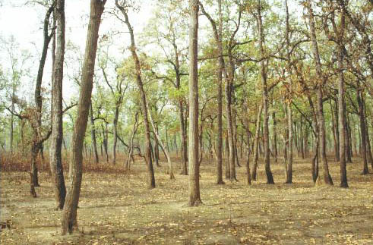
Tropical Deciduous Forest

Slide 9
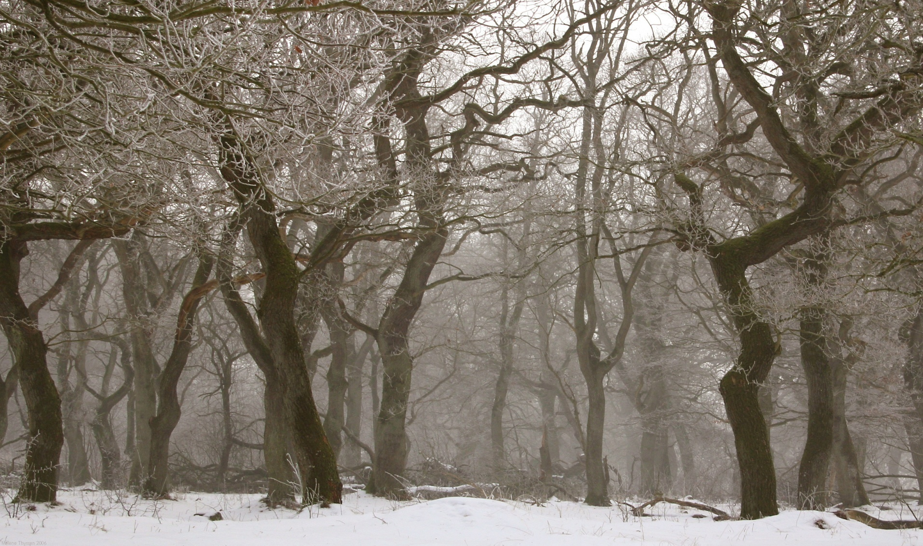
Temperate Deciduous Forest

Slide 10
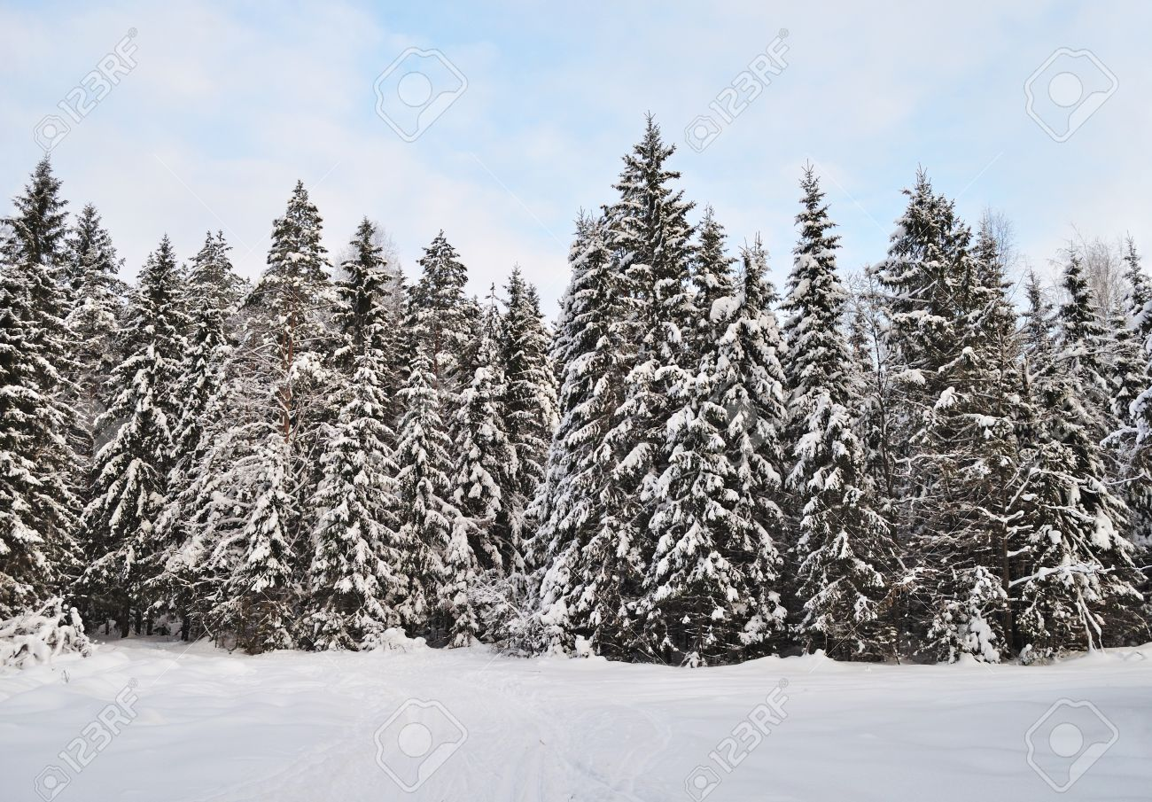
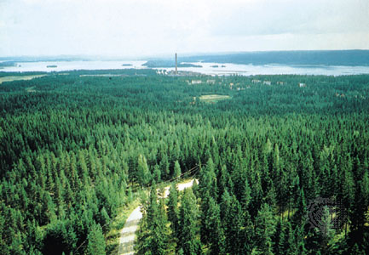
Coniferous Forests

Slide 11
Importance of forests
Provides food, fuel, charcoal.
Raw Materials for paper industries.
Maintains the equilibrium of atmosphere by photosynthesis.
Protects the soil erosion, landslides, and loss of soil fertility.
Plays a role in global climates.
Oxygen factories of Earth.

Slide 12
Importance of forests
Provides shelter to animals, humans and millions of micro organisms.
They are the sources for natural medicine.
It preserves the soil temperature.
It has high aesthetic value.
It lowers the temperatures of surroundings.

Slide 13
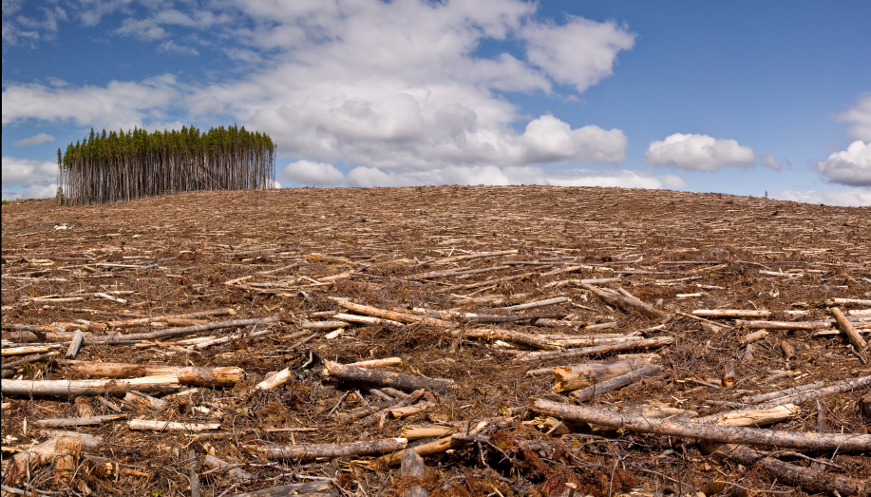
Deforestation

Slide 14
Reasons for Deforestation
Growth of Human Pollination.
Industries and Road, Dam Construction.
Mining Operations.
Industrial demand of wood.
Timber Extraction.
Climate Changes.
Forest Fire.

Slide 15
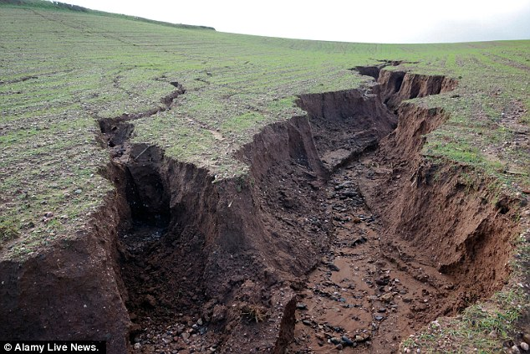
Effects of Deforestation
Soil Erosion.

Slide 16
Effects of Deforestation
Soil Erosion.
Loss of Biodiversity.
Climate Change.
Global Warming.

Slide 17

Forests conservation act 1980

Slide 18
Forests conservation act 1980
No forest land or any portion thereof may be used for any non-forest purpose without the prior permission of the central government.
No state government or other authority may issue order directing that any forest land thereof may be assigned by way of lease or otherwise to any private person or to any authority corporation.

